Slide 1
Plotting with Pandas
Lesson 5.2

Slide 2
How comfortable does everyone feel after the last class?

Slide 3
Warm-Up Activity: PyPlot
Instructions | Open the unsolved activity file, and examine the starter code for each dataset. File: Unsolved/plot_drills.ipynb
 | Determine what chart or plot best fits with the starter code for each dataset.
 | Complete the code block to create a plot for each dataset.
 | Be sure to provide each plot with a title and labels.
Hints | If you are unsure about what type of data is contained in the starter code, print it out!

Slide 4
Warm-Up Activity: PyPlot
In this activity, you will use PyPlot to create the most effective visualization for a variety of datasets.
15 minutes

Slide 6
Plotting Pandas Data

Slide 7
Imaginary datasets are good to practice with...
Notes:
-------------------

Slide 8

...But we will deal with real-world data more often.
Strange formats
Messy
Missing data
Misleading headers

Slide 9


How to Work with Messy Data
Pandas enables us to quickly and easily:
Rename headers
Remove missing data
Convert and clean up column data
In most cases, we will work with real-world data in Pandas.

Slide 10
The Creators of Pandas Are Geniuses!
Most people who read datasets into Pandas will:
Clean and preprocess their data
Visualize their findings using Matplotlib
Pandas creators added Matplotlib functionality directly into Pandas, which:
Speeds up the process of creating lists and aesthetics
Best of both worlds
Still allows for PyPlot customizability

Slide 12
Activity: Union Settlements
In this activity, you will create a bar chart that visualizes the total number of major collective bargaining settlements by select unions in 1995.
20 minutes

Slide 13
Activity: Union Settlements
Instructions | Use Pandas to load the union_settlements_1995.csv dataset.
 | Create a Series containing the number of settlements made by each union.
 | Using this Series, create a bar chart with red bars.
 | Adjust the figure size of the plot. Add a title and axis labels.
 | Use your data to retrieve labels for your x-axis ticks, and rotate them 45 degrees.
 | Display your plot. Which union agreed to the most settlements? The fewest?
Bonus | Find out how many national settlements were agreed to by each union, and plot the national totals alongside all settlement totals.

Slide 15
Plotting Groups

Slide 16
How do we group data in Pandas?

Slide 17
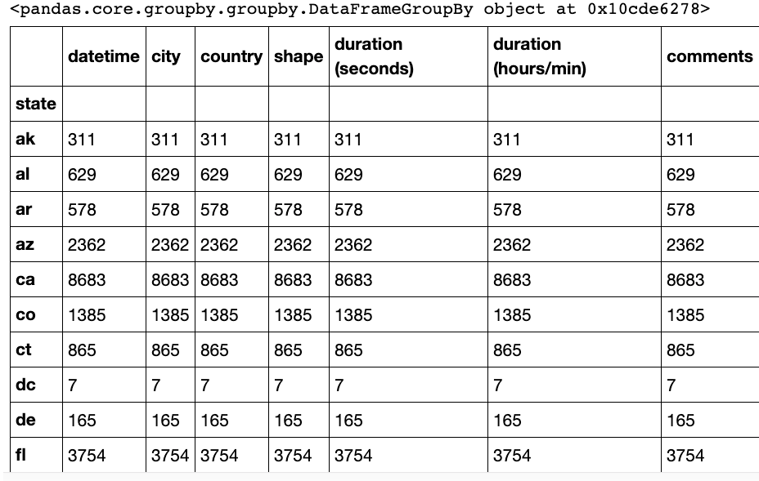
Grouping and Summarizing in Pandas
The dataframe.groupby() function allows us to group data.
Data can be grouped by function or category.
The output of the function is a GroupBy object.

Slide 18
Grouping and Summarizing in Pandas
To return a DataFrame from a GroupBy Object
df.groupby('state').mean()
To return a Series from a GroupBy Object
states = df.groupby('state')
states = states['city'].mean()

Slide 20
Activity: Library Usage
In this activity, you will create a pair of charts based on library usage collected from San Francisco.
20 minutes

Slide 21
Activity: Library Usage
Instructions | Open the starter file provided, and follow the prompts to import, split, and summarize the library usage dataset. File: Unsolved/library_usage.ipynb
 | Create a bar chart, using Pandas and Matplotlib, that visualizes how many library patrons checked out items from the library by patron type.
 | Create a pie graph, using Pandas and Matplotlib, that can be used to visualize the total items checked out by patron type of a single home branch, 'Home Library Definition'.
Hint | Since there are quite a lot of patron types with minimal checkouts, you may like to include a filter to limit the minimum number of total checkouts by patron group.

Slide 23


Slide 24
Activity: Miles per Gallon
In this activity, you will create a scatter plot by using vehicle data, Pandas, and Matplotlib.
15 minutes

Slide 25
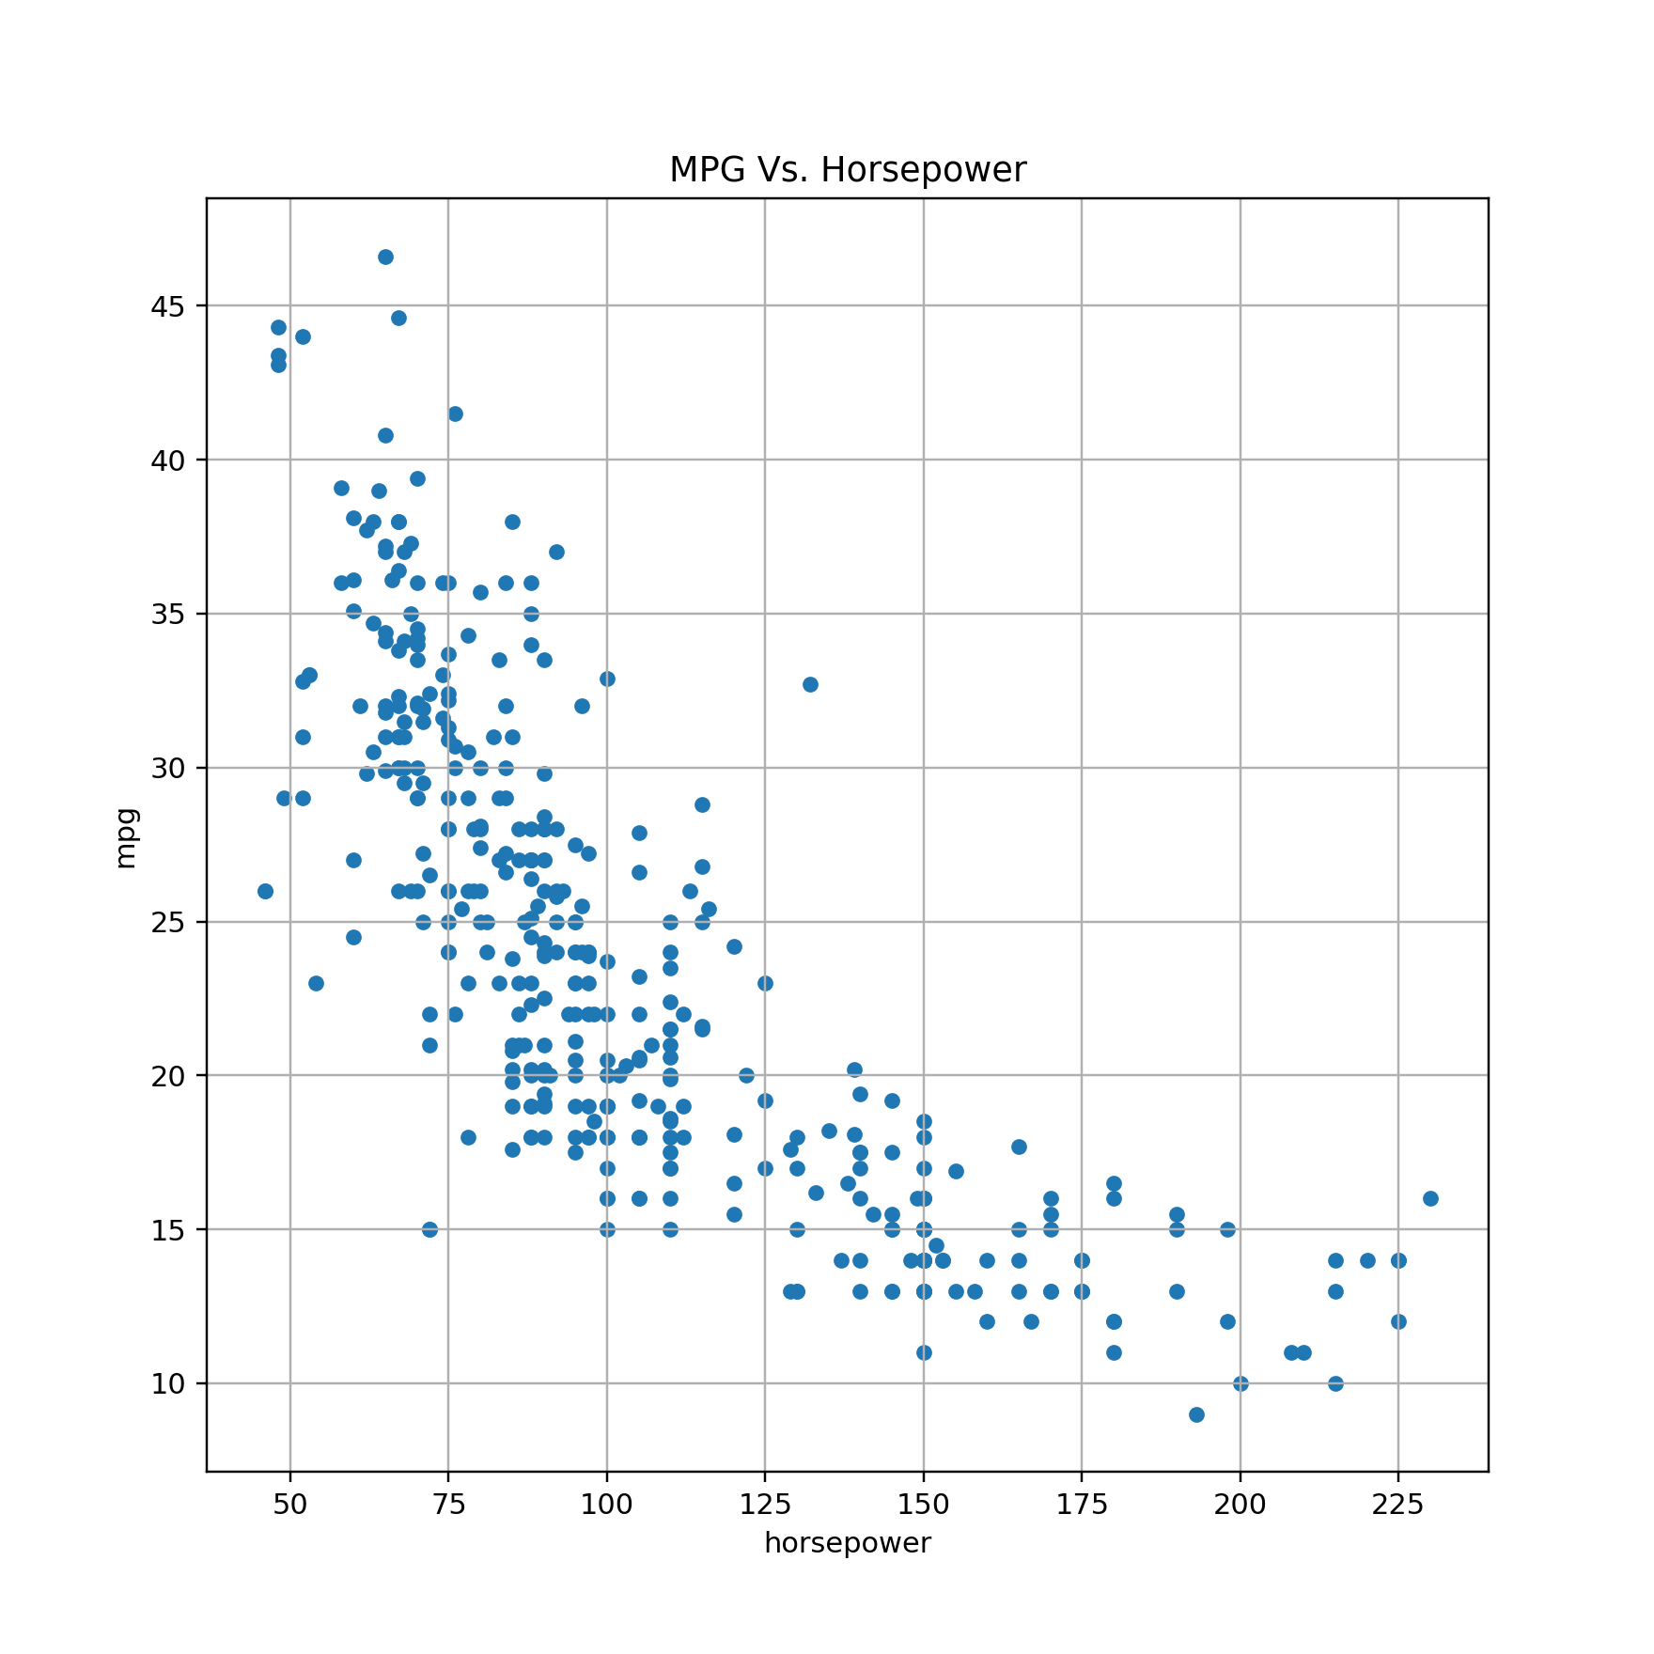
Activity: Miles per Gallon
Create a scatter plot, using the data provided, Pandas, and Matplotlib, that compares the MPG of a vehicle with its horsepower.
File: Resources/mpg.csv

Slide 27
Plotting Multiple Lines

Slide 28
With Pandas, Adding Multiple Plots Is Easy!
We have learned how to use Pandas to:
Generate line, bar, pie, and scatter plots.
Plot summary figures by using GroupBy objects.
But what if we want to combine multiple plots in the same figure?
Adding multiple plots to Pandas is the same as in PyPlot:
Add multiple plots in the same code block.
Show the combined figure by using pyplot.show().

Slide 30
The remainder of class will consist of a group mini-project.
The mini-project will be broken up into three parts.
Every few minutes, we will review the previous part.

Slide 31
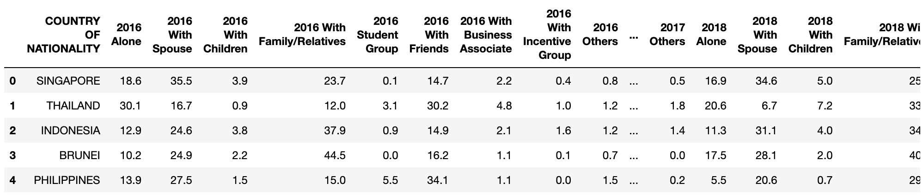
Group Mini-Project: Traveling Companions, Part 1
Follow the instructions for the activity in the unsolved Jupyter Notebook file.
File: Unsolved/traveling_companions.ipynb
Your output should align with the following table:

Slide 33
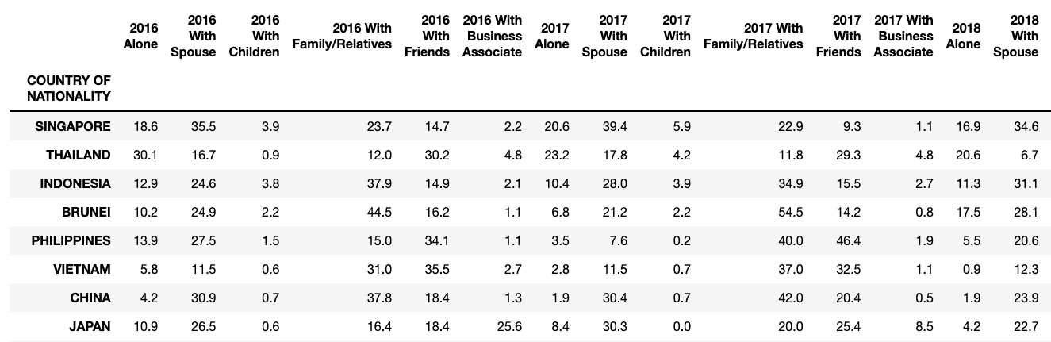
Group Mini-Project: Traveling Companions, Part 2
Follow the instructions for the activity in the unsolved Jupyter Notebook file.
File: Unsolved/traveling_companions.ipynb
Your output should align with the following table:

Slide 35
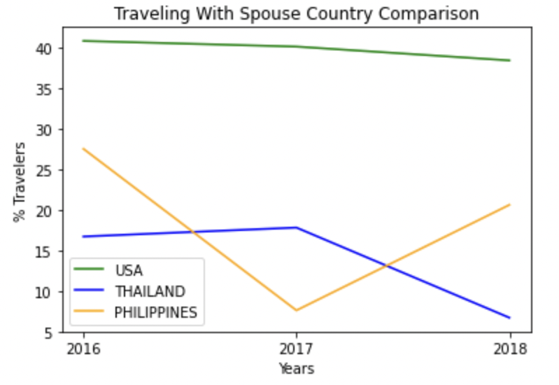
Group Mini-Project: Traveling Companions, Part 3
Follow the instructions for the activity in the unsolved Jupyter Notebook file.
File: Unsolved/traveling_companions.ipynb
Your output should align with the adjacent figure, depending on the user’s input variable.

